Slide 1
ADVANCED MACHINE LEARNING PROJECT
By Jatin Palchuri (jp5881) and Tamoghna Chakraborty(tc3142)

Slide 2
TITLE
Compression techniques for Semantic Segmentation

Slide 3
Why semantic segmentation models profit from compression?
Traditionally used Deep Convolutional Networks for segmentation are very large and cumbersome.
These networks are highly accurate, but not efficient
For use in embedded systems & mobile networks, highly efficient models are required.
Hence, compression!

Slide 4



Quantization
The process:
A scaling function is defined: Here, v is the weight vector
The quantized value is given by:
So,

Slide 5



The function Q’ can be defined either as uniform or non-uniform placement of quantization points.
Uniform Quantization: No. of quantization levels s+1 is fixed.
Non uniform Quantization: No fixed s, instead a set of points is supplied and each element of the weight vector is quantized to the closest of these points.

Slide 6
Knowledge Distillation
A technique to distill knowledge from a teacher(generally larger network in the context of compression) to a student(more compact) network
Several ways: Distillation of class probabilities, transferring the intermediate feature maps, etc.

Slide 7

Pixel-wise Knowledge Distillation
Straight forward scheme.
Class probability for each pixel produced by the teacher network are used as soft target for training the student network
Loss function(l): If S is the student network and T is the teacher network,
Where R={1,2,.....W*H} denotes all the pixels and KL(.) is the KL divergence between the two probabilities (class probabilities of ith pixels of S and T respectively)

Slide 8


Structured Knowledge Distillation
Pair-wise Knowledge Distillation transfers the relation between all pairs of pixels from the teacher to the student network.
The similarity between two pixels is simply computed from the features xi and xj as:
Loss function(l):

Slide 9
EXPERIMENTS

Slide 10
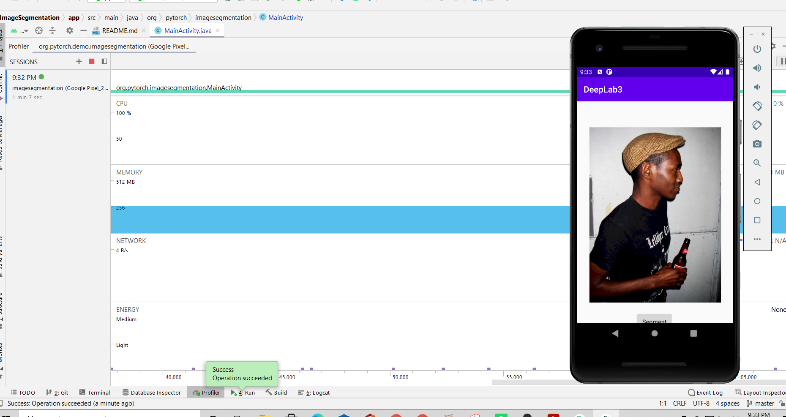
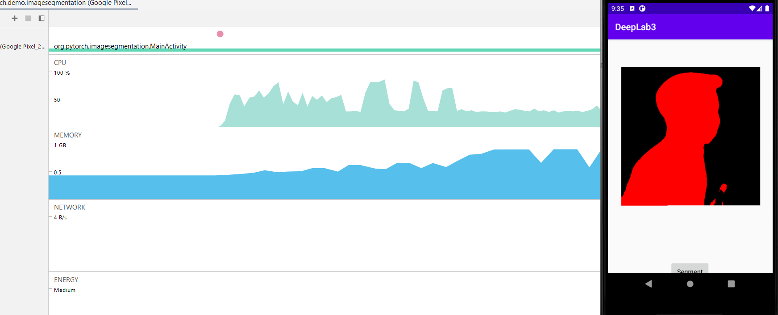
Resnet 101 -DeepLab V3 on Google Pixel 2a
Model Test miou on Complete Pascal voc dataset =67.24
Number of parameters 60M
Model Test miou on Human images =69.34
Model file size 240 MB

Slide 11
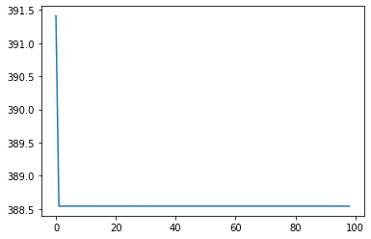
UNet 21 on PASCAL VOC
lr=1e-5,batch_size=8,momentum =0.6

Slide 12
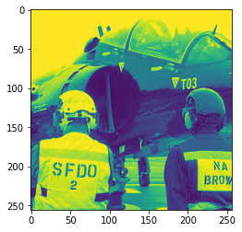
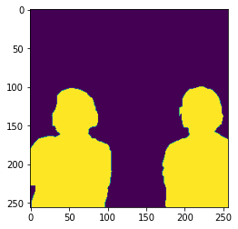
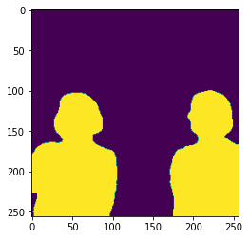
UNet for Human detection
Subset of Pascal voc with 300 train and 144 test images consisting of only human labels
Test miou 69.45, number of parameters 31M, model size is 110 MB
Input
Predicted
Ground truth

Slide 13
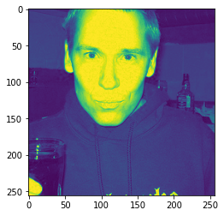
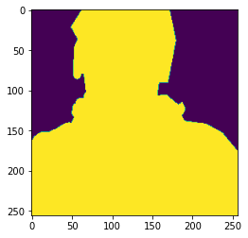
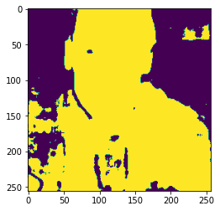
UNet for Human detection with KD
Test miou =54.29
Teacher : Resnet 101-Deeplabv3
Input
Ground truth
Prediction

Slide 14
POST-Training QUANTIZATION
UNet with observers
TrainingImages
Train using Cross entropy loss
256x256x3
Place the observers and calibrate the observers.
Quantize the model

Slide 15
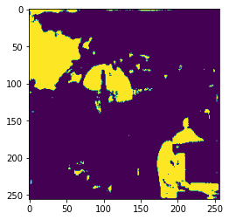
POST Training Quantization
Test miou 35.78,number of parameters 11M
Input
Ground Truth
Prediction

Slide 16
QUANTIZATION Aware Training
UNet with observers and fake quantization modules
TrainingImages
Train using cross entropy loss and fake quantization modules
256x256x3
Place the observers and calibrate the observers.
Quantize the model

Slide 17
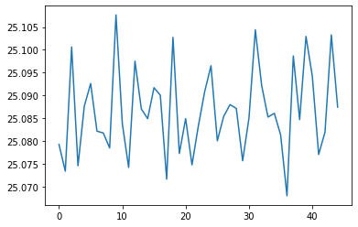
QUANTIZATION Aware Training Loss
lr=1e-6,batch_size=8

Slide 18
QUANTIZATION Aware Training with KD
UNet with observers and fake quantization modules
TrainingImages
Train using (cross entropy loss+KD loss) and fake quantization modules
256x256x3
Place the observers and calibrate the observers.
Quantize the model

Slide 19
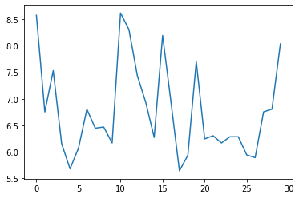
QUANTIZATION Aware Training with KD Loss
lr=1e-6,batch_size=8,lam=0.4

